Slide 1
GRAPHQL

Slide 2
REST HAS SOME PROBLEMS
Over Fetching
Under Fetching

Slide 3
Why these ‘problems’ matter
Increased mobile clients (smart phones and smart devices) requires efficient data loading
Client Heterogeneity ( Example: Admin client vs Order Page -> accessing list of customers-orders)
Faster development and deployment and rapid feature updates (hmm….grain of salt)

Slide 4
A little bit of HISTORY
A Facebook (Meta) contribution
Facebook started using it internally since 2012
Made it public in 2015 (in a React.js Conference) and open sourced
Lot of major companies have migrated their endpoints (or created new ones) to support GraphQL

Slide 5
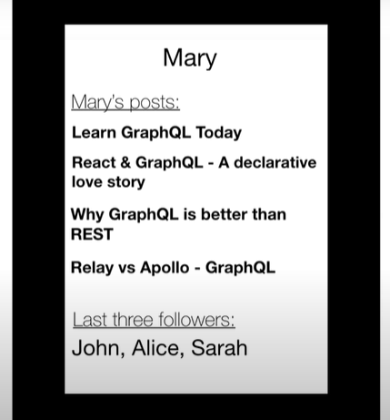
Graphql vs REST (BLOG APP)
Print User Information
List of Posts
List of latest 3 followers
Lets assume that the data is normalized
i.e. there are separate tables for
User
Posts
Followers

Slide 6
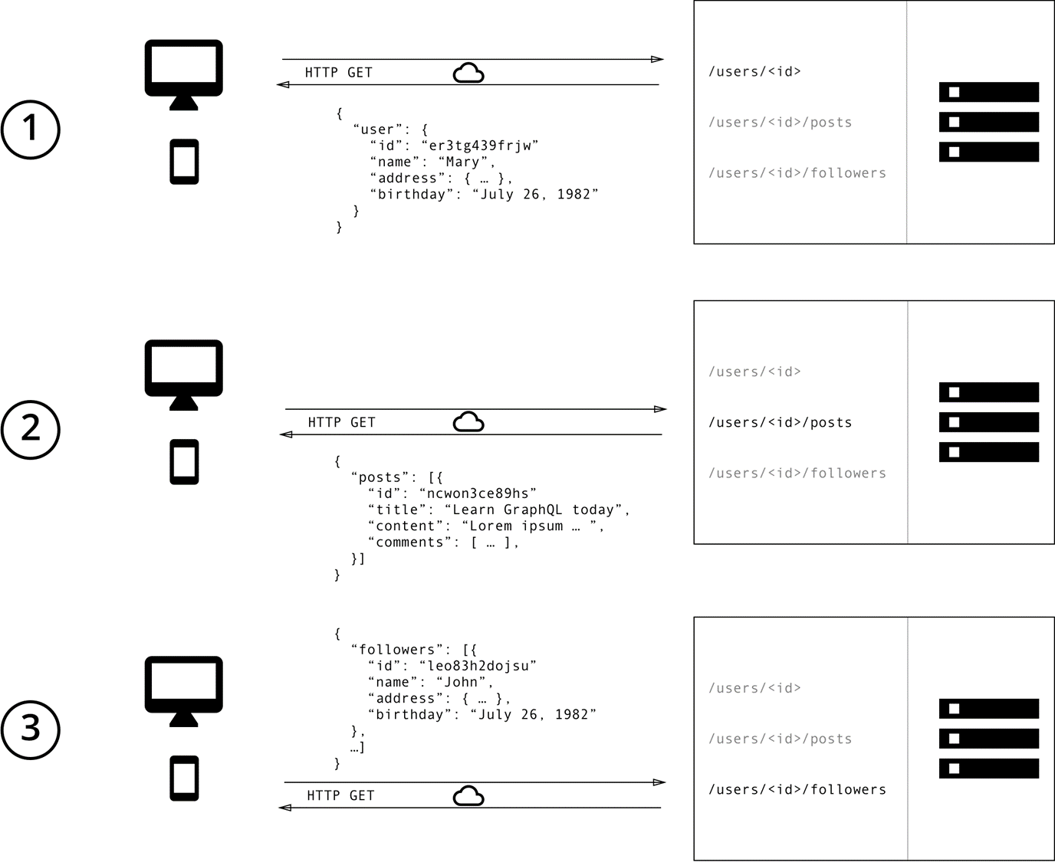
Graphql vs REST (BLOG APP)
First Get The User Information

Slide 7
Graphql vs REST (BLOG APP)
Second Get The Posts Information

Slide 8
Graphql vs REST (BLOG APP)
Finally Get The Followers Information

Slide 9
How does the same thing looks in GrAPHQL?
Lets see!

Slide 10
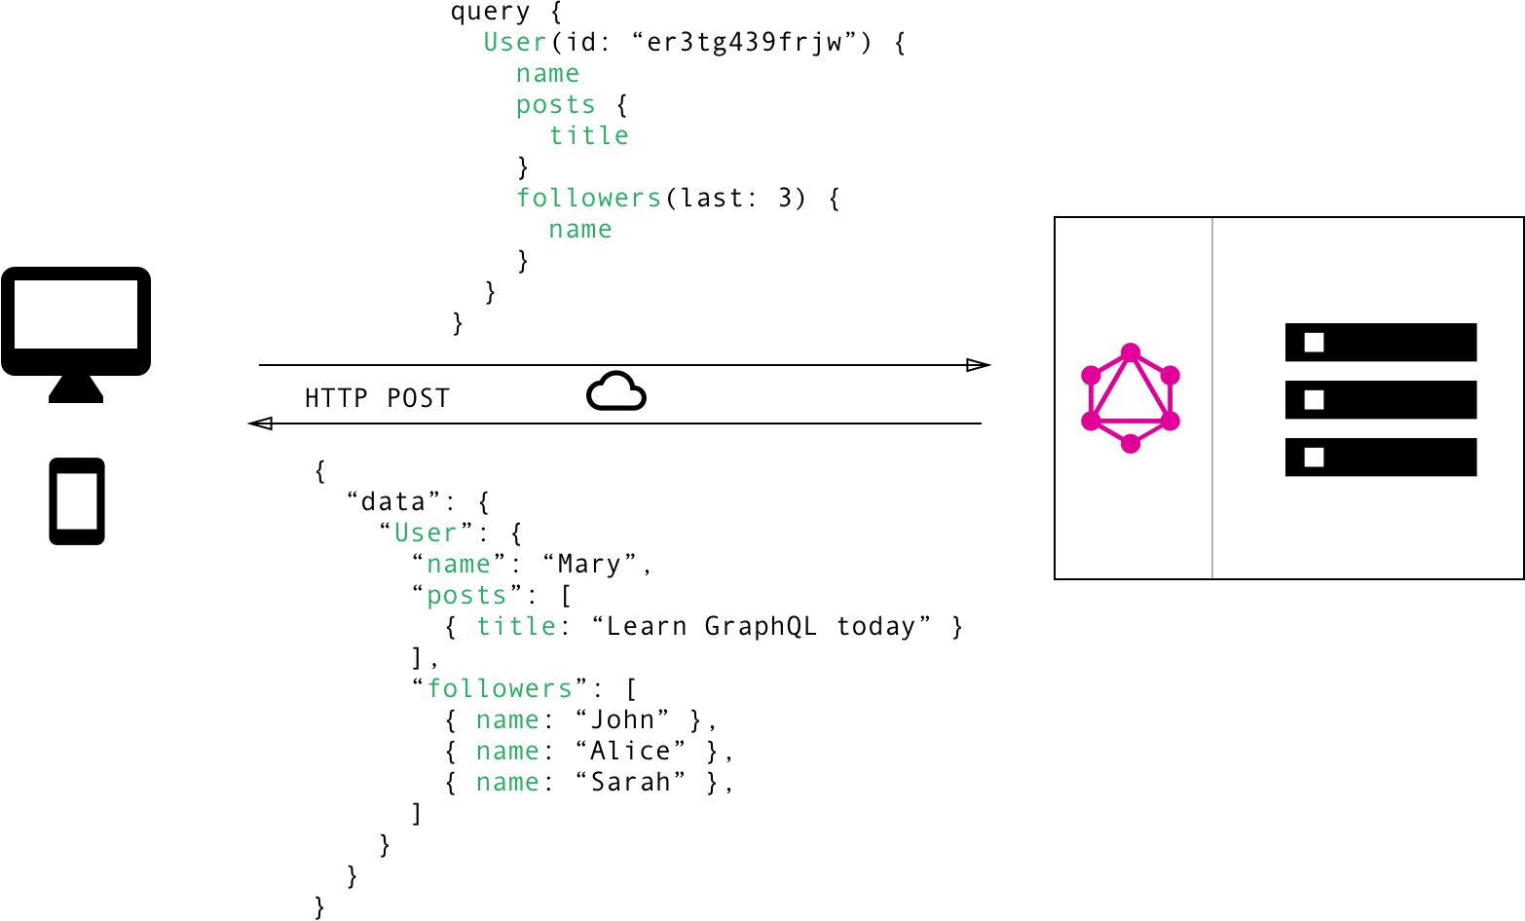
Specify Only What you need
That’s exactly what you get

Slide 11
Another Major Benefit: Types & SCHEMA
GraphQL uses a strong type system to define capabilities of the API
Resource hierarchy as Type hierarchy
The schema defines the contract between the client and the server
Once there is an agreed upon schema
The front-end and back-end development can proceed independently

Slide 12
GRAPHQL CORE CONCEPTS

Slide 13
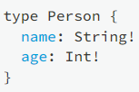
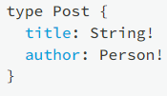
The SCHEMA DEFINITION LANGUAGE (SDL)
SDL for simple types
Bang indicates ‘required’

Slide 14
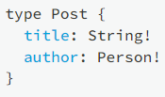
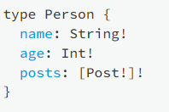
The SCHEMA DEFINITION LANGUAGE (SDL)
We can easily add relationships between types (similar to OOP)
Lets see how we can add one-to-many between person and posts
[ ] indicates collection

Slide 15
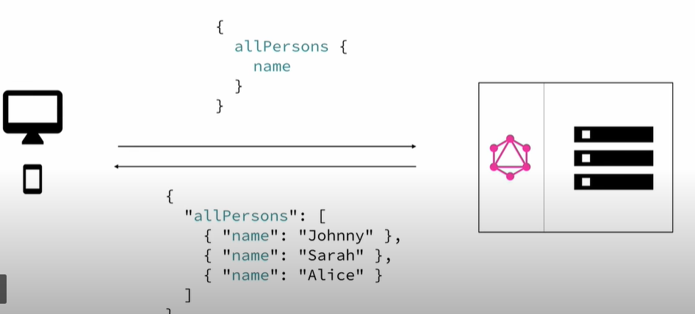
Basic GRAPHQL QUERIES
Root-field
Payload

Slide 16
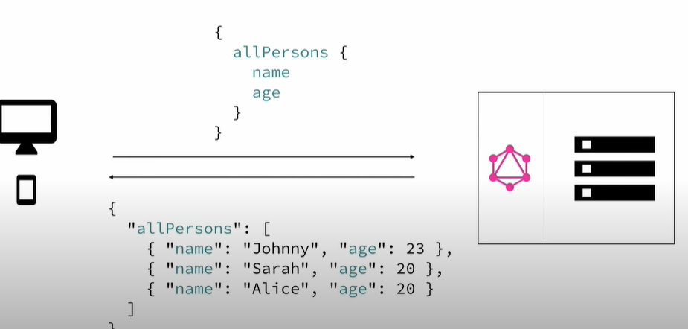
Basic GRAPHQL QUERIES
Root field
Payload (modifying the payload slightly gives us more data)

Slide 17
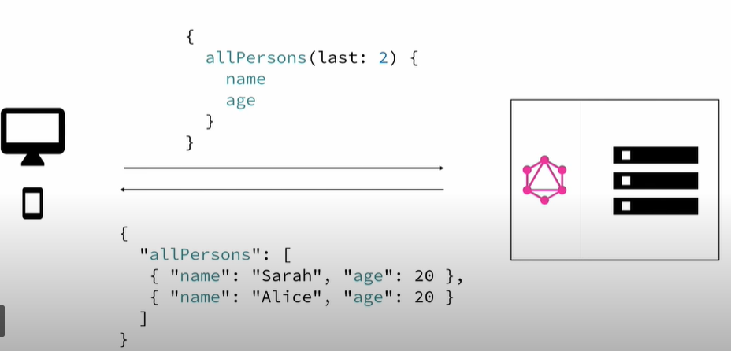
Basic GRAPHQL QUERIES
Queries can accept parameters
We can design parameters as we wish and support it in the backend

Slide 18
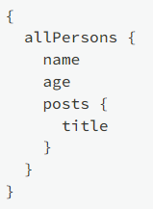
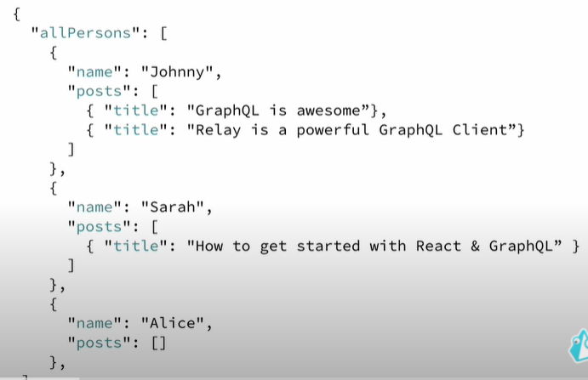
Basic GRAPHQL QUERIES
The beauty of GraphQL is the ability to support nested Queries
Remember our person+posts schema

Slide 19
Changing data (mutations)
Creation of new data
Updating existing data (both full and partial updates)
Deletion of data

Slide 20
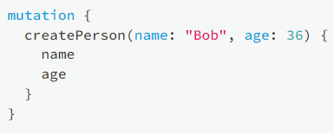
Mutations
Same syntactic structure as queries, but always starts with the mutation keyword
Example of a createperson mutation

Slide 21
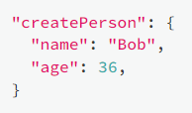
Mutations
Same syntactic structure as queries, but always starts with the mutation keyword
Example of a createperson mutation

Slide 22
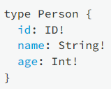
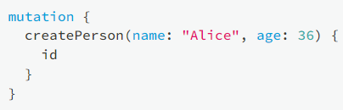
Mutations
One common pattern is to use the ID GraphQL type for uniqueIDs

Slide 23
Mutations
Update Mutations does not require anything special
You just pass in ID as one of the params, along with the params that needs to be updated

Slide 24
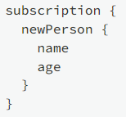
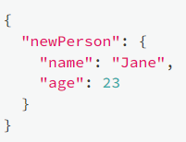
SUBSCRIPTIONS
Another notable advantage of GraphQL is support to streaming Data
Subscriptions represent a stream of data sent over to the client
You subscribe to events and when that event happens the data you asked for is sent over
Note: Subscription is out of scope for us. We don’t expect you to stream data. You are free to explore more on your own.

Slide 25

Lets Revisit schema
Schema is simply a collection of GraphQL Types
However (in convention) we prefer some typical root types, especially for APIs
These are the entry points (Query, Mutation & Subscription).
When you don’t specify anything it defaults to Query

Slide 26


Lets Revisit schema
Example of Query with just allpersons
Example of Query with improved allpersons, where you can specify limit

Slide 27

Lets Revisit schema
Example of createperson mutations

Slide 28
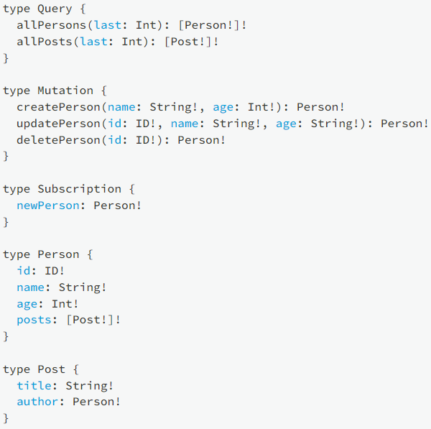
Final
Full
Schema

Slide 29

Reference
https://www.howtographql.com/

